Slide 1

NYC Citi Bike Data Analysis Project
Presented By: Alexis Brito

Slide 2

Main Question : How can we optimize bike inventory and services in New York to get more costumers? To Answer the main question, I need to know about this: What are the peak usage hours during weekdays versus weekends? How does the average trip duration differ between Members and Casual users? Which stations have the highest Start vs. End disparity?
Introduction

Slide 3

How Benefits?
Benefits for Lift or Department of transport in NYC : Better logistic, higher utilization, targeted marketing, optimized infrastructure.
Benefits for the costumers and city people:
Better promotions, more bikes is busy areas, job opportunities

Slide 4




Methodology: Data & Tools
Dataset
Key Features
Citi Bike Trip Data (Jersey City) from July 2025.
Trip duration, start/end station IDs, customer type, time/day of trip.
107,726 individual bike trips.
Tools Used
Jupyter Notebooks, Python (pandas, matplotlib, seaborn).

Slide 5

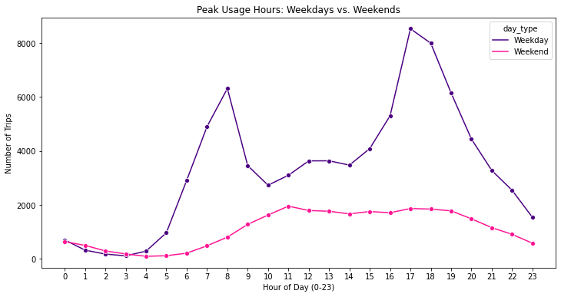
What are the peak usage hours during weekdays versus weekends? Weekdays show clear peaks (8 AM & 5 PM) indicating heavy commuting use. Weekends show a two, large peak for recreational trips.

Slide 6
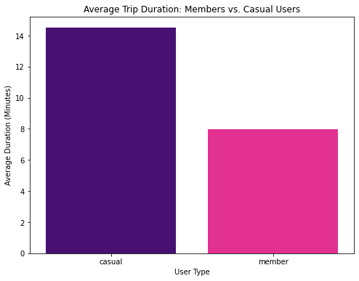
How does the average trip duration differ between Members and Casual users? Members: Median trip duration is 9.5 minutes. Suggests efficient, short-distance commuting. Casual Riders: Median trip is 14.6 minutes. Indicates longer, potentially recreational use.

Slide 7
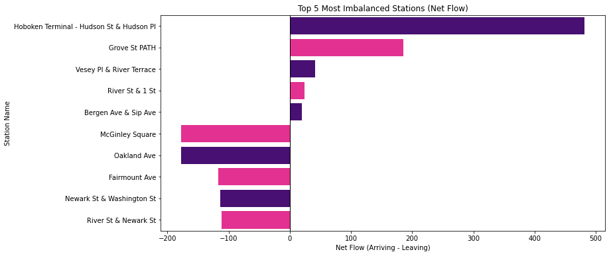
Which stations have the highest "Start" vs. "End" disparity? Stations show significant net flow imbalances based on Start/End trips. Rebalancing logistics must prioritize these locations.

Slide 8

Future Work & Next Steps
Unanswered Questions:
Impact of severe weather on ridership?
Actual cost of rebalancing along top routes
Future Work:
Integrate real time weather data.
Compare July 2025 with year over year data.
Develop predictive demand
models.

Slide 9
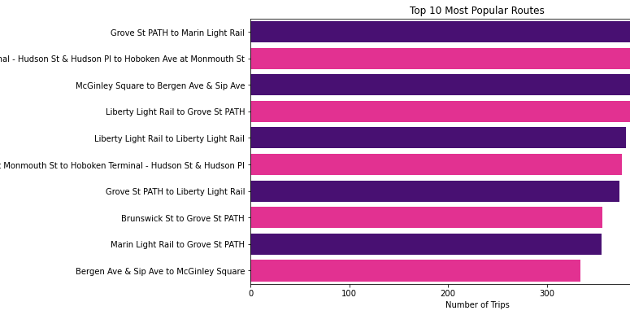
Appendix: Data Filtering Rationale
To make an accurate analysis of typical use: Outliers trips lasting less than 1 minute or more than 60 minutes were identified and removed.
This graph and questions was removed because it wasn’t relevant to my main presentation.

Slide 10

Thank You Questions?

